Slide 1
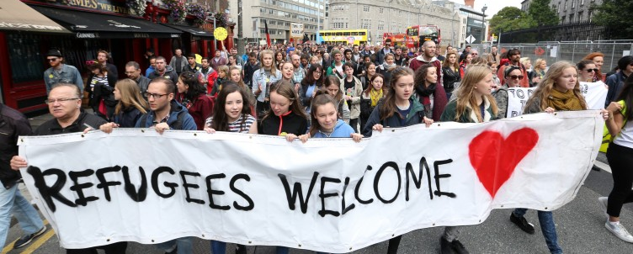
Pro-Refugee
By Alex

Slide 2
Hi My name is Alex and I am doing my project on the pro refugee siding while my fellow classmate Jake is looking at the anti-refugee side.
Here we will be looking at the key topics and key figures.

Slide 3
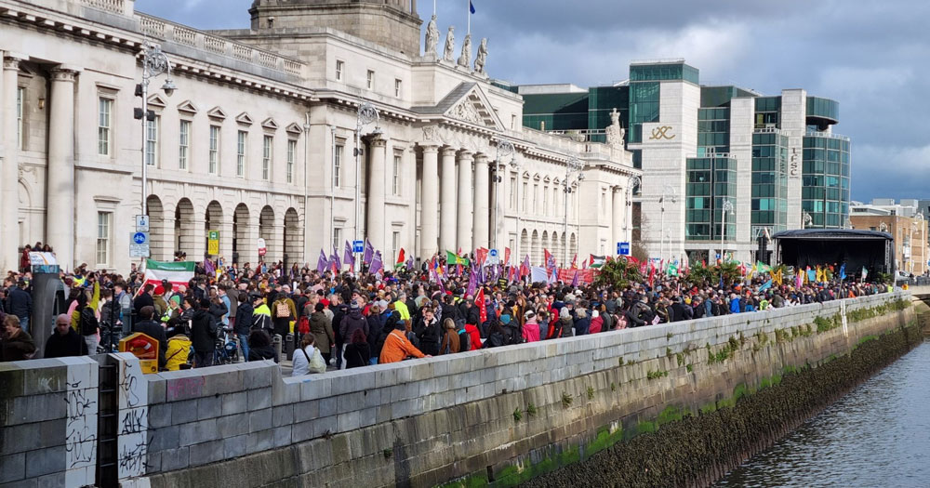
Protests For Pro-Refugee in Dublin City
Tens of thousands of people turned out for the ‘Ireland For All’ solidarity march that took place in Dublin on Saturday, February 18. The large crowd gathered to stand in opposition to the recent wave of anti-refugee protests that happened in the Dublin.
Demonstrators gathered in Parnell Square and marched down O’Connell Street, ultimately arriving at Custom House Quay, where a stage had been set up for a number of speakers and musical acts. According to the organisers, as many as 50,000 people were present at the march to stand in solidarity with migrants and refugees.

Slide 4
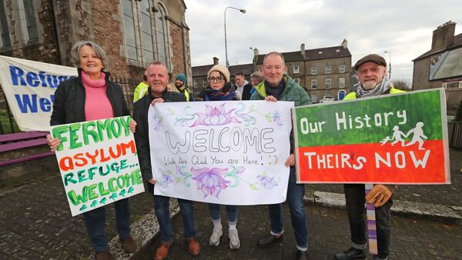
Protest in fermoy Co'Cork
Up to 300 people gathered in Fermoy for a rally in support of refugees and asylum seekers.
It followed a protest on a night before by dozens of people outside an accommodation centre in the town where 66 recently arrived international protection applicants are staying.
At today's rally, people of all ages gathered with banners and chanted "Refugees welcome, asylum seekers welcome".
One of the organisers, Kate O'Connell, said: "If you live here, you belong here. Fermoy is your home."

Slide 5
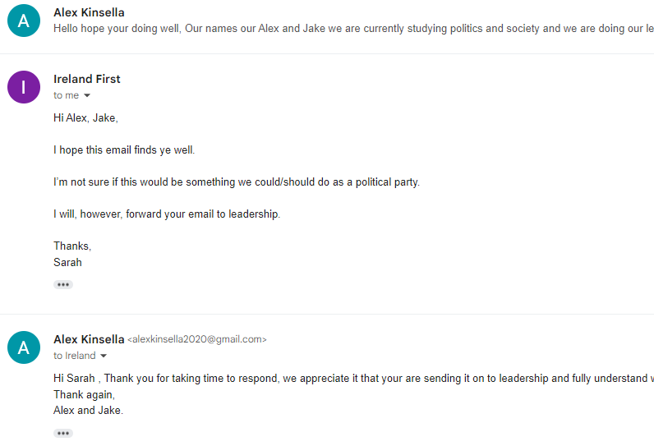
Key Parties and figures.
We tried reaching out to Ireland First a far right party led by the Infamous Derek Blighe. As you can see here they quickly shut us down when asking for a quick summary of what they stand for.

Slide 6
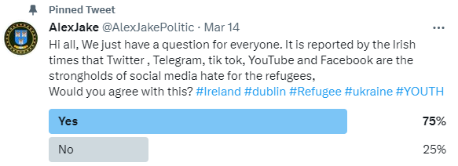
Social Media
As you can see here it was reported by the irish times that these social media platforms were a lot of hate for refugees was coming from. We took matters in our own hands and decided to find out for ourselves. We put a poll up asking to the people Do they think this is true or not. It turns out Most people do think its true

