Slide 1
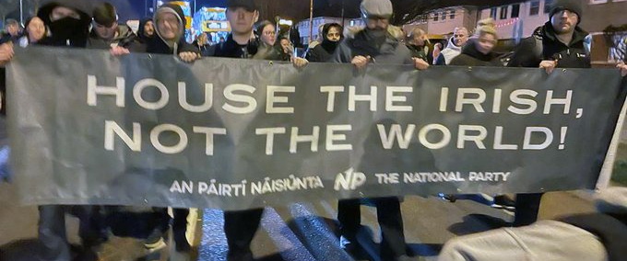
Anti refugee protests

Slide 2
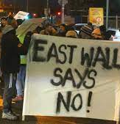
East wall protests
More than 100 people gathered outside the old esb building to protest against the housing of refugees inside it.
The protesters then marched along the east wall road when they made their way to dublin port tunnel and blocked the exit and flowing traffic from continuing on.

Slide 3
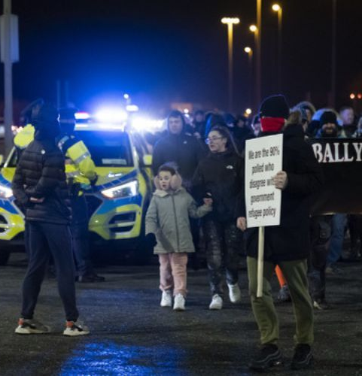
Ballymun protest
Locals gathered outside a hotel within ballymun to protest against the housing of refugees in the area, protesters continously chanted 'send them home' as well as intimidating asylum seekers inside the hotel.

Slide 4
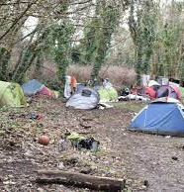
Attack on migrants
Attack on homeless migrants along the tolka river in Dublin, Ashtown.
Minister Joe O'Brien had his say on the incident, “I was shocked, I was disgusted,” Joe O’Brien said of the incident in Ashtown. “It’s very worrying. I’ve worked in the area of migrant rights for 20 years plus, I’ve never been more worried about the safety and security of migrants in the country than I am now,” he told RTÉ radio.
This articles comes after it was reported that a group of homeless men were attacked at the Tolka river at River Road in Ashtown at the weekend, with journalists witnessing men with dogs and sticks arriving at the campsite.
Garda added that they had heard reports of an incident within the area but no formal complaints had been made.

Slide 5
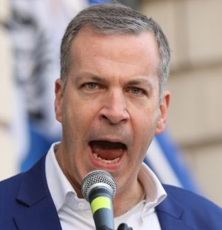
Hermann kelly
Hermann kelly is an irish political candidate and former journalist.
Hermann is the current leader of the far-right irish freedom party.
The party believes in controlled immigration “to suit the interests of ordinary Irish people” and closed borders to solve the current housing crisis.

Slide 6
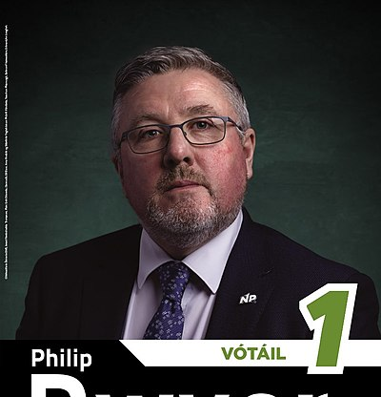
Phillip dwyer
Philip dwyer is a national party candidate in dublin south-west.
stood as a candidate in the 2020 general election for the National Party but failed to get elected.
An activist at demonstrations against refugee centres all around the country, he believes “at least” 90% of refugees coming into the country are “economic refugees”, and routinely refers to “fake asylum seekers” and “so-called refugees”.
He said in one video live streamed in Dublin’s East Wall recently that he had spoken to people who had “strategies up their sleeves to escalate” matters if the former ESB office building was not closed as an emergency accommodation centre to refugees.
in another new video, Mr Dwyer filmed himself at the front office of a Government department asking to speak to the minister about how their department “supports paedophilia” because it was displaying a number of rainbow flags in its front ground-floor windows.

Slide 7
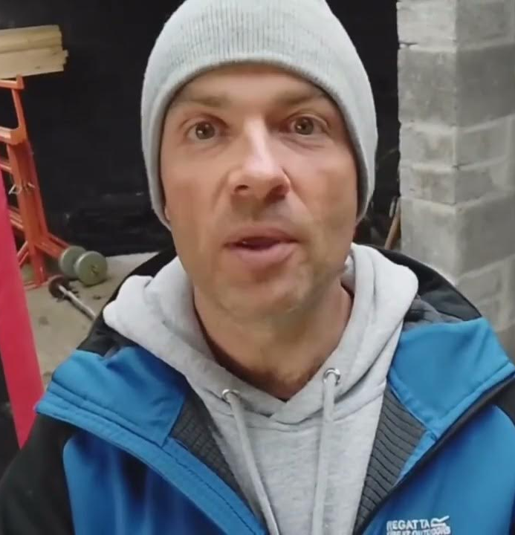
Derek blighe
The 42 year old native cork man leads a group called Ireland first, they describe themselves as a nationalist party although they are not a registered political party.
They show right wing ethnopluralism theories and campaigns for Ireland to leave the European union.
Derek has been travelling up and down the country attending protests in places such as Athlone, cork, Killarney, Wicklow town and East Wall in Dublin city centre.
He records these protests and public speaking to share to his followers on social media.
He describes the Ukraine and Russia war as a “smokescreen” and a “fake war publicised to encourage economic migrants to come to this country and benefit from our liberal housing policy”.

Slide 8
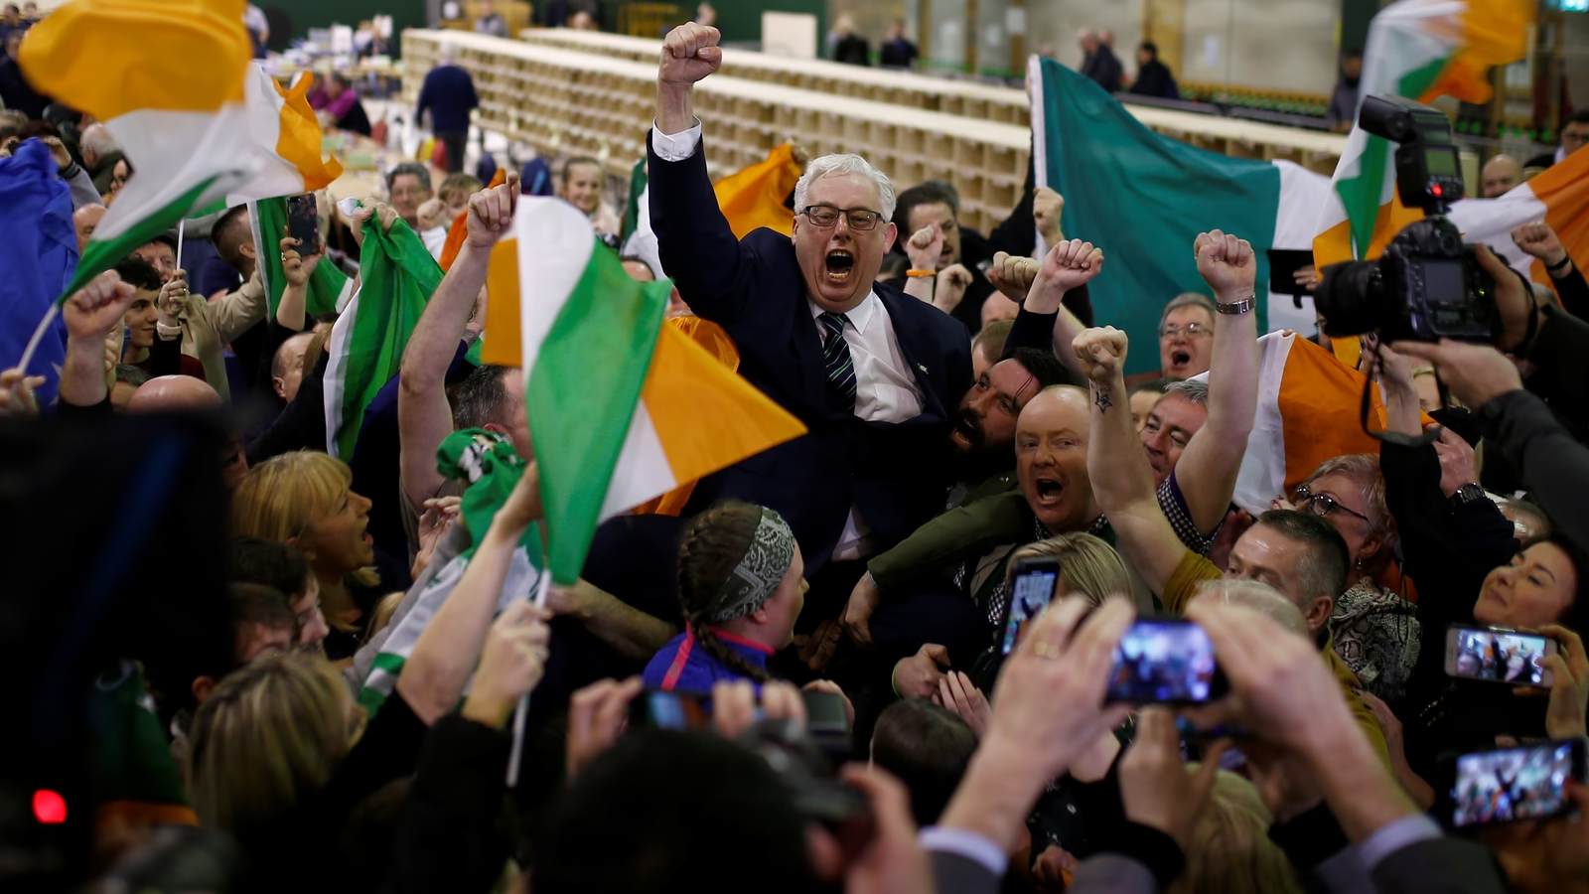
Irish national party
Irish national party was founded in 2016 by james reynolds and justin barret.
Justin is the current leader with james being the deputy leader.
They are described as being right wing – to far right, Barrett has called for a complete ban on Muslims entering Ireland and for greater vetting efforts to be made, he also made a statement where he said "they all could be potentially dangerous".
The party also share anti-abortion, anti LGBTQ+ and anti-immigration views to their followers and to the general public.

Slide 9

Social media aspect
Social media platforms such as facebook and twitter play a big role in how information is shared about this topic, whether that be the good or the bad as it comes from both sides.
Derek blighe is very active on twitter with nearly all his posts targeted at asylum seekers coming into the country and his outrage about it, as well as his followers outrage.
The narrative Derek is trying to promote now is that the gardai are trying to get people to keep quiet about sexual assault attacks from these groups pf people and remove posts online about 'foreign nationals' who may be involved in these attacks.

Slide 10
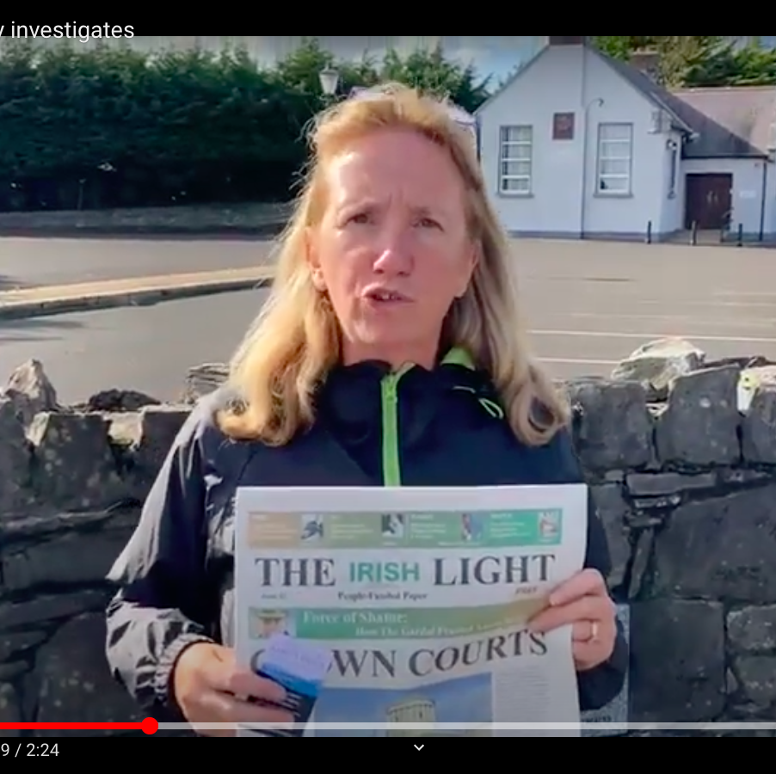
Gemma O'Doherty
Gemma is an Irish far-right activist as well as a conspiracy theorist.
Gemma was banned on twitter for sharing her views as some people would call them controversial, Gemma believes that to be fully Irish you have to be white and a catholic born in the country and anything else doesn’t count.
Gemma is a former journalist and last november was charged for breaking covid regulations by travelling from dublin to cork when restrictions were in place.

Slide 11
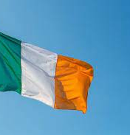
Hatred and fear
The figures I have mentioned in the previous slides are notorious for spreading fear and intimidating messages online to try and prevent refugees and stop immigrants from entering the country.
Spreading these messages and views online can be very harming for young individuals who use the site and can influence them into having beliefs that aren't morally right.
Overall I do believe that the figures do truly think they are only trying to help although more harm can be done then good...

Slide 12
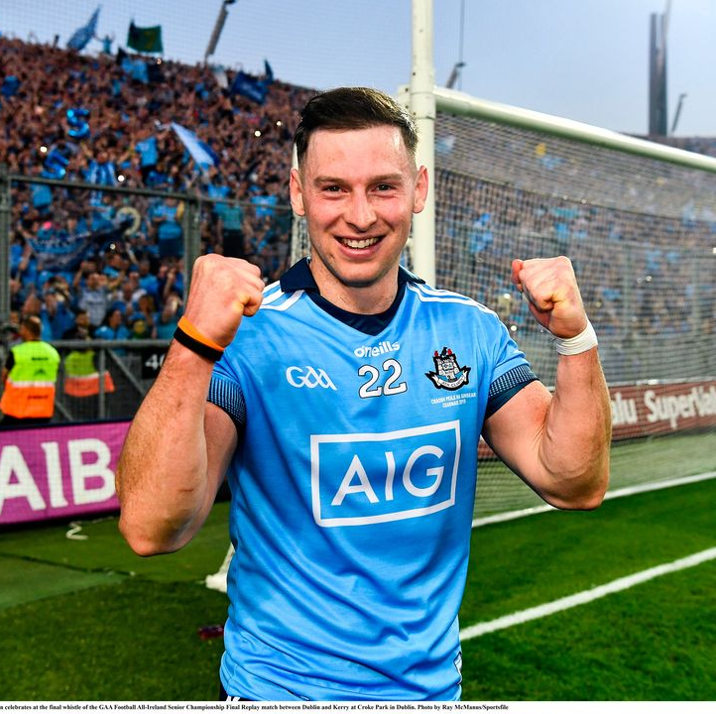
Philly mcmahon
The best message out there and the one young people on social media should be listening to is that of ex Gaa dublin star philly mcmahon.
He sums up the whole argument really well as he comes from the pro-immigration side of the argument, he points out the hypocrisy in some of the anti-refugee prominent figures as well as how their views are spreading negativity online.

