Slide 1
Being the Adult in the Room
ONE approach to dealing with the Leaving Cert History Research Study Report (RSR)
This is just how I do it. You’ll find your own way to do things as time progresses.
Target Audience: Teachers who are new to LC History (but may be a useful refresher for others!)
The basic premise that I’m working towards here is: “Stuff I wish I’d been told about carrying out the RSR with students before I had to do it for the first time…”
Dr Jerome Devitt – Cork HTA, October 2022

Slide 2
Why I think that the RSR is the single most important piece of writing that most students do in the entire Leaving Cert process…
“The Art of Writing is the art of RE-WRITING”
There are virtually no other areas of LC where methodical structuring, drafting, and redrafting of written work (based on constructive feedback) is really possible. This has been made all-the-more important because of the removal of essay writing at the JC level in English/History…
Other subjects, such as Geography, Religion, Politics & Society do have written components, but they are much bittier…
This is the one area where a sustained effort in the construction of an ARGUMENT is possible. This possibility (even if not every student achieves this…) should be the teacher’s overarching goal in the RSR process. The English and Pol-Soc teacher will thank you for giving this its due attention!
It’s the one true chance we get to demonstrate that EVERY discipline/interest “has a history”.
It allows us to get to know our students, forge links with subjects across the curriculum, introduce the idea of interdisciplinarity, and make a broader contribution to learning…
It’s the Leaving Cert task that most closely resembles the many of the standard kinds of assessments that students will encounter in the arts/humanities/social sciences in university…
Knowing what makes as student ‘tick’ helps with their choice of topic…

Slide 3
Before you begin the process
Introduce the idea early in 5th year so that students are aware of what is coming down the road
Make sure that they understand the range of possibilities (and constraints) provided by the RSR (particularly DATE ranges and word-count)
They’re going to have to “sit with” the RSR for a long time, so it needs to be a topic that will sustain their interest and engagement
Establish clear criteria for what should underpin their choice of topic
  I make an “RSR Proposal” document 10% of their 5th Year summer grade to help the students understand that it will have a big bearing on their final grade, even if they ultimately go on to change their topics (about half DO change their topic over the summer of 5th-6th year)
Illustrate examples of “Bad Choices” so that they know what to avoid – this can save enormous amounts of time ‘down the line’!
  Sports history that only tells the events of the match – (they’re not commentators)
  Family history that lacks overt significance – (no, I don’t care what your granny says)
  Titles that are too close to the exam topics that they might have to write an essay on - particularly Case Studies or key personalities. (No marks for the same material twice…)
  It can be a huge advantage to ‘steer clear’ of the obvious topics – examiners might spot the mistakes!

Slide 4
Things an LC History teacher should be aware of:
1. The Students…
We all think that history is SUPER IMPORTANT, but this is ONLY ONE of the LC Students’ projects – Depending on their subject choices, students might also be submitting Economics, Geography, Religion, Politics & Society and/or Ag Science… on or around the same time as your deadline
Mock exams won’t have been long finished as the date for final submission approaches – student burnout is a real thing…
Oral exams and other practical components are also coming in ‘thick and fast’ around Easter
If you start the RSR too early (i.e. Mid-fifth year), the students most likely haven’t developed the writing skills to get the most out of the process.
If current plans go ahead to move English & Irish Paper 1 to June of 5th year, then there’s little chance that the students will do meaningful work on any projects in May of 5th year. I may be wrong about this…
Where possible, students should use MS Word/Google Docs to draft and submit their work. This makes editing drafts an order of magnitude easier…

Slide 5
Things an LC History teacher should be aware of:
2. The Teachers…
Because this is the most “high tariff” aspects of anything the students do in class, you need to place it at the centre of your planning process.
You may also have 2nd and/or 3rd Year CBAs to work on at that time. Your time is a precious resource too, don’t forget!
It takes considerable time to give due feedback on single project. You need to manage your workload! I can only effectively do 2 RSRs a night – and that’s if I have nothing else to do that night!
Life keeps happening for both students and teachers while the RSR deadline approaches
The Result:- you need to plan for contingencies in your overall approach to the RSR, otherwise you WILL run into difficulties… I have MANY, MANY, MANY, MANY times… Don’t expect yourself of your students to be perfect at this. (You should see how disorganised, hair-brained, and full of self-doubt that most PhD students are… seriously!)

Slide 6
“Sometime a bad decision is better than no decision…”
To come to some kind of provisional choice ask some or all of the following questions…
Academic Focus
What other subjects are you studying?
What parts of the LC courses in those subjects are you most interested in?
Have you selected your 1st, 2nd, 3rd, CAO choices? Could we dig into the history of those disciplines a little (Medical History, Architectural History, Economic History, Agricultural History, etc…)
What are your academic strengths and weaknesses? Play to your strengths (obvs!)
Is there a topic you’re covering in another subject/project you want to develop further here the (‘two birds/one stone approach’!)
Personal Focus
Do you have a family member or ancestor who was involved in an historic event that you’d be particularly interested in researching?
Do you have a favour film/novel/play whose context you’d want to find out more about?
What are your past-times? Are their moments of broader significance in that area that you’d want to pursue?
Is there anything a ‘bit random’ that you’re just personally intrigued by?
If you’re really struggling do you want me to be more active in choosing a topic for you? What might I meaningfully suggest?

Slide 7
Pastoral Issues – More common for an English teacher, but not unusual for LC History…
By choosing a particular topic, sometime students may be trying to implicitly communicate with their “one good adult”…
I’ve had a student choose the 1969 “Stonewall” riots as a way to come out as gay. They didn’t want me to tell their parents their choice of topic (ultimately, they changed the topic to avoid that conversation), another chose the Nazi’s use of the “pink triangle”…
I’ve also had a student who wanted to complete an RSR on Albert Cashier, a transgender Irish emigrant who served in the US Civil War. It led to a conversation that had a deep resonance for the student…
Minority representation. We still have a very Euro-centric and male-centric course. If you have minority groups in your class, this might be the one time that have an opportunity to undertake meaningful study of that background. Give them a voice and agency in your class.
Be wary of your own interests! Sometime a student who might want to study something else might choose a topic dear to your heart because they want to please you – maybe something you mentioned off-hand in class many months previous. Don’t let your ego and the flattery deter students from what they are really interested in…
Your ear should always be attuned to pastoral issues in the class!
Students genuinely appreciate when you concede that you don’t know everything and are looking forward to learning from the expertise and knowledge that they’ll be communicating to you during the process ahead. Approach students with a sense of humility and intellectual generosity.

Slide 8
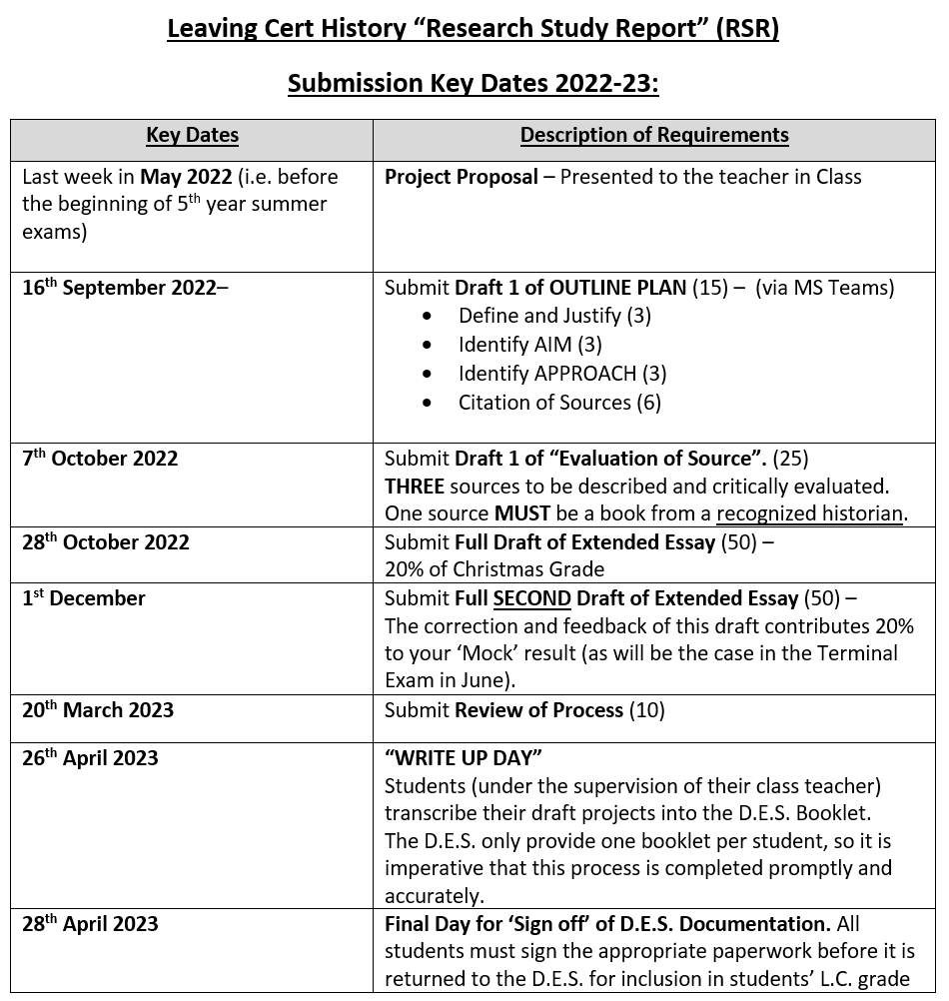
A Provisional Timelines
Make sure the students know where they stand!
This can only serve as a guideline, needing to be adapted every cycle and probably will be re-adjusted during the year too!
Year to year, this will obviously vary, depending on issues such as your school’s…
  Start date
  Mid-term dates
  Scheduling of your Christmas/ Mock exams
  Dates for orals/other projects/ significant school dates
  Do you need to make a comment on the process for a Parent-Teacher meeting? If so, plan for that in advance – and let the students know you’re doing that!

Slide 9
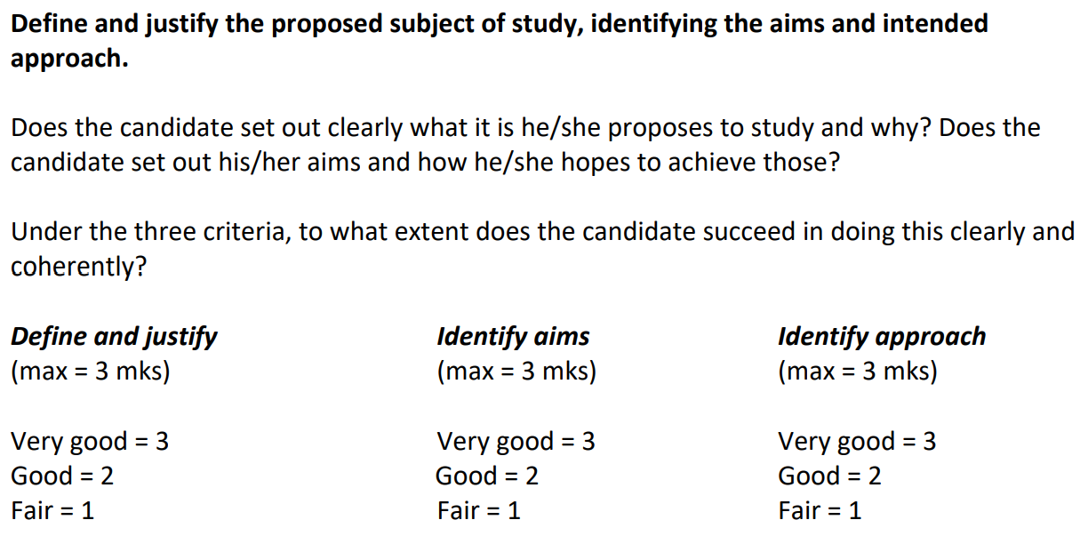
Some issues to consider with the OUTLINE PLAN
D & J: – Not a rehashing of the title, but an explanation of the limits of the subject. 1-2 sentence to clarify “scope”
  “This is historically significant because…”
  If they can’t answer this question (explicitly or implicitly) they haven’t properly justified their choice.
Aims: Identify THREE aims – for a more coherent structure, rank in terms of priority.
  “My primary aim is… My secondary aim is…”
Approach: Equivalent to a ‘methodology’ section in other historical writing.
  “To achieve these aims I will…”
Avoid overly generic writing. Address methodological issues that will be salient to the topic chosen and the sources you have at your disposal.
Remember, no red pen for sub-headings – it won’t scan properly!
Here’s what the SEC Marking Scheme says…
Don’t forget the SUB-HEADINGS to make the examiner’s life a little easier!

Slide 10
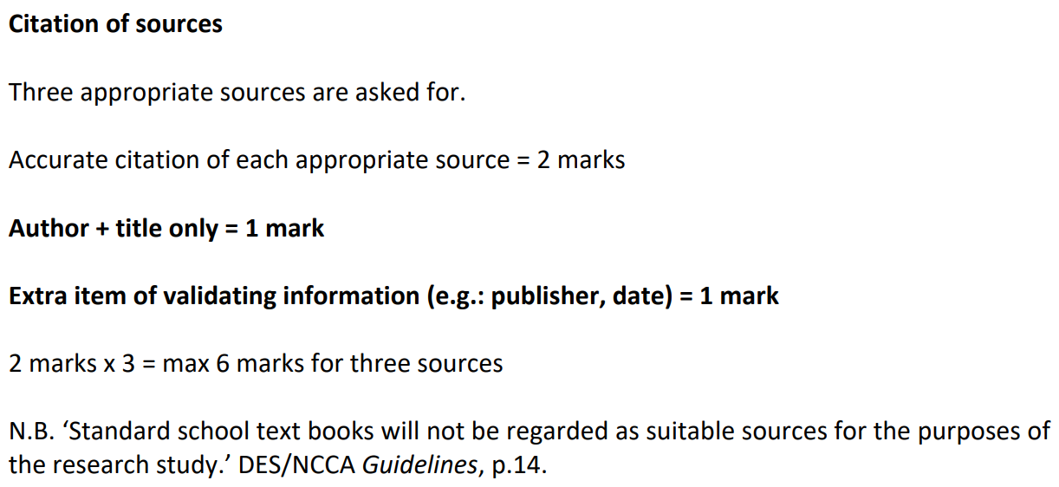
Citation of Sources – The easiest section, but with most marks unnecessarily dropped!
This is actually a chance for you to embed the ‘skills of an historian’ in your classroom!
Here’s what the marking scheme says:
See additional Handout!
The best way to introduce this is to explain WHY this is done…
Transparency of research
Reproducibility of findings
Avoiding a charge of plagiarism
Research in the spirit of intellectual honesty and generosity
The first step towards establishing the strength of your “Research Skills” in the Extended Essay
Model the kinds of skills that students will need at Third Level.

Slide 11
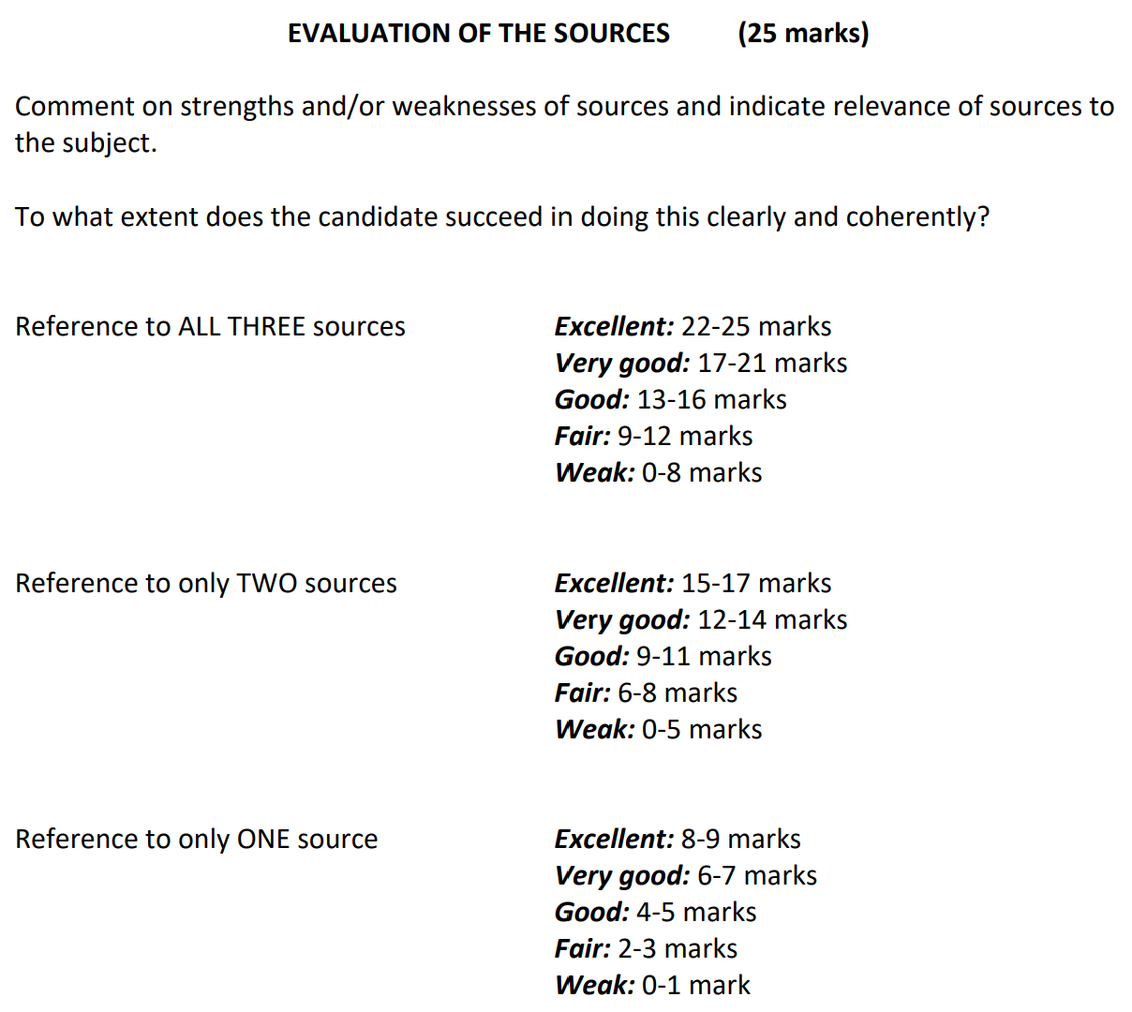
Evaluation of Sources:
Here’s what the SEC says:
Note that it’s NOT a ‘source by source’ mark, it’s a cumulative expression of the examiner’s sense of the evaluation completed. Does this allow for compensation between sources? (…3 doesn’t divide neatly into 25!)
But what does that mean in reality, and what should the teachers do to help students to move this process along?

Slide 12
Evaluation of Sources: A progressive approach
Things you MUST do:
Things you should TRY to do:
Brief description of the source – primary/secondary, podcast, website, academic journal article… objectivity/subjectivity
Demonstrate the source’s RELEVANCE to your topic: “This sources was relevant to my topic because…” or “My most relevant source was…” (Rank in order)
Identify the STRENGTHS: (sub-heading!) of the Source (general and technical)
Identify the WEAKNESSES: (Sub-heading!) of the Source (general and technical
Comment on the Authorship of the source
  Certification - M.A./PhD?
  Professor in University?
  Other technical considerations – consider their profession and its relevance to the topic under discussion
  These aren’t a guarantee of reliability, but from a student’s perspective are a good 1st Step
Track Record of Publication (this and other topics). How much and where have they published before?
Their position within the historiography (“schools of thought”) – H1 students…
Bias? Involvement in events? (Biography/Autobiography in particular)

Slide 13
What kinds of things might you focus on in your Strengths and Weaknesses in your evaluation of sources?
General Considerations might refer to…
Technical Considerations might refer to…
General writing style
Accessible Layout
Use of Technical Language/Key Terminology
Chapter/Paragraph Structure
Potential Bias of Authorship/Involvement in action
Genre/Source Specific language & layout
Chronology/Thematic approaches
Footnotes
Bibliography
Appendices
Photographs
Illustrations
Maps
Glossary/Abbreviations
Hyperlinks/show-notes/oral history considerations

Slide 14
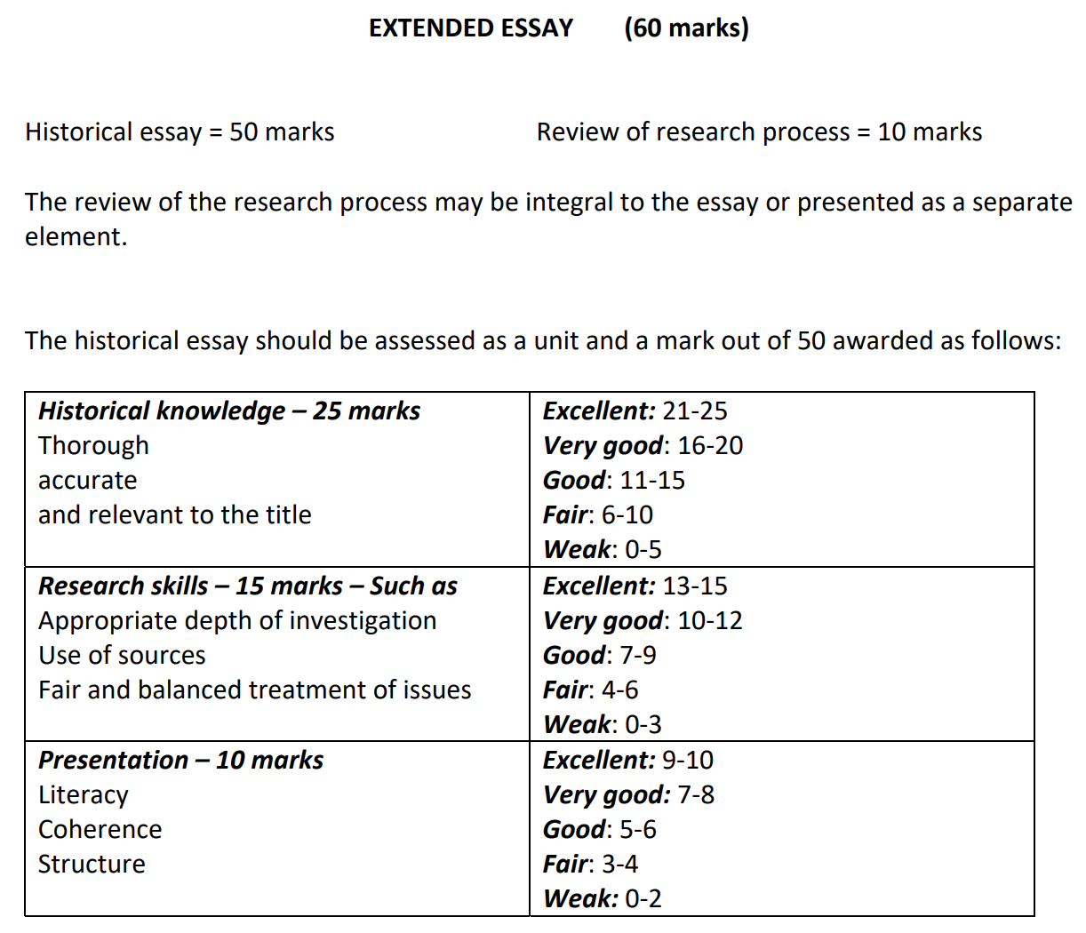
Extended Essay – 50 Marks
Here’s what the SEC say:
Do we have a clear sense of what each category means?
More particularly, how do we convey these poorly defined criteria to our students?
What are the elements of good practice or mistakes that will move students from one classification to another?

Slide 15
The Process itself – General points for teachers to consider
The most engaging RSR are those that show a clear mastery of the content, but also craft an argument.
  “It’s not what you know, it’s what you can do with what you know!”
Content knowledge is the prerequisite and it’s what you should aim for first – particularly in the mid-ability and weaker students. This may be as far as some students get (particularly OL students), but that’s ok…
Proper ‘differentiation’ (a term I’m not super comfortable with) sees students move through a process of
  Purely narrative history → A reasoned argument where students fully justify their claims
The importance of the TITLE – Are the students presenting WHAT happened, or WHY something happened. The latter nearly always produces a more engaging argument. Even where you know that students will return to and re-draft their title at the end of the process, they do need a ‘working title’ in order to maintain their focus throughout the process.

Slide 16
What if a student can’t craft an argument?
Students often struggle with maintaining control of a longer piece of writing (for most, this is the longest thing they’ll ever have written, for others it’s the longest thing they will ever write.)
Encourage students to focus disproportionate attention on the opening sentence (Thesis Statement) of each paragraph
Ask them “If I only read the first line of each paragraph, would I understand the argument you’re trying to make?”
Using the grid on the next page, get the students to write JUST the first sentence of each paragraph, ensuring that they don’t unnecessarily start or end a paragraph with content/information.
Remember, if a student does ‘go rogue’ during the writing process, you can always return to the title at the last minute and adjust it to fit what they have actually done! You’d be amazed at how often this ends up saving an RSR!

Slide 17
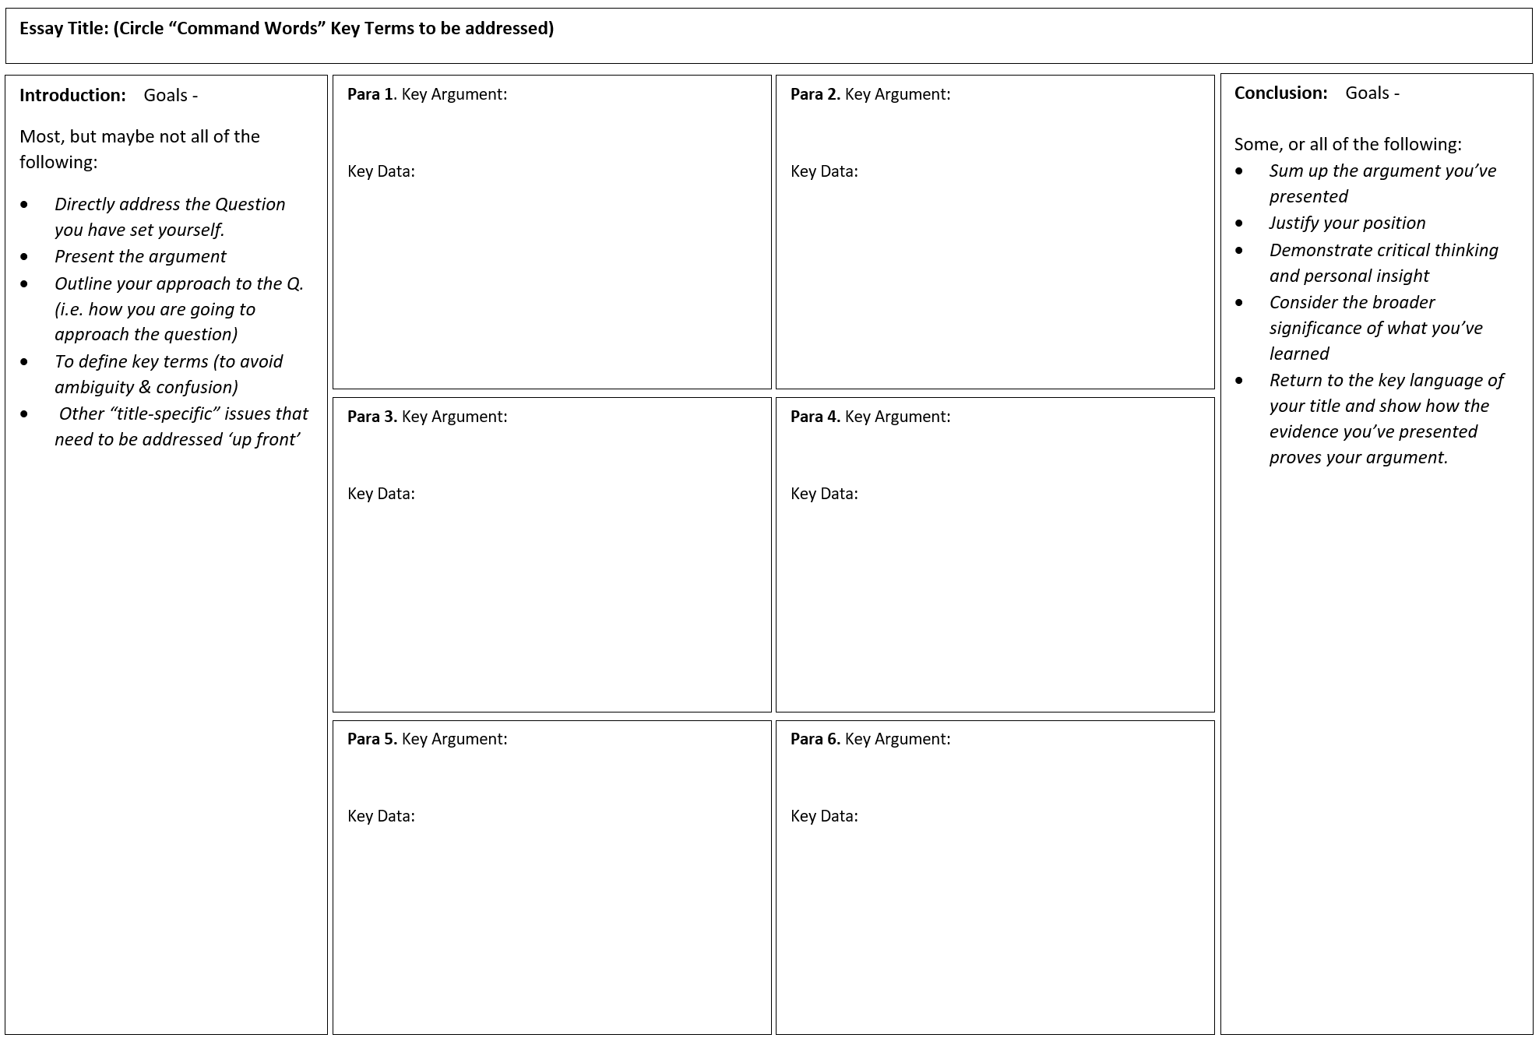
“Gridding” your argument:
Students only write the first line of their Intro and each paragraph in each box.
↓
Check for ARGUMENT over CONTENT in each thesis statement.
↓
Check for CHRONOLOGICAL or THEMATIC consistency in the presentation of the argument.
↓
Deductive/Inductive reasoning (students don’t have to understand the specific terminology, but do need to understand the ‘flow’ of the argument).
↓
Do they move from the:
Specific → General
General → Specific
↓
Introduce the idea that the closing line of a paragraph can serve as a link to the next idea being presented.
↓
Not all will ‘get’ this, but when some do, it makes all the difference!

Slide 18
A trick for ensuring top marks in the ‘Research Skills’ (15 marks total)
Layer your sources into your work…
  “As historian X has argued…”
  “In her treatment of this topic, Y suggest that, “…..”
  “Interestingly, X’s interpretation of this event differs to Y in certain ways.”
  “The primary source material quoted by historian X indicates that…”
  “Consulting the map/appendix/quantitative data in source Z, we see that…”
Footnotes are NOT obligatory, but can help to reinforce the examiner’s perception that you’ve engaged broadly with the source material!
  Be consistent with footnoting practice.
  Do the footnotes in long-form in MS Word and don’t transcribe until the final draft has been approved by the teacher
  “Ibid” can be your greatest ally, or your worst enemy
  If you can successfully illustrate the value of footnotes, you’ll have done your students a considerable service when they get to 3rd Level.
  You don’t have to go mad with the footnotes. 12-15 would more than suffice to achieve the desired goal!

Slide 19
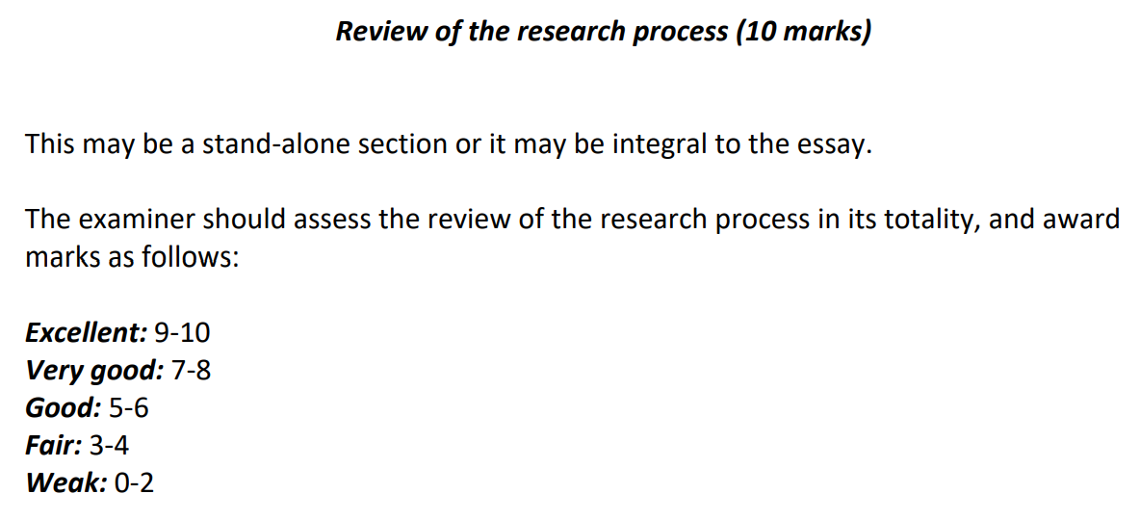
Review of Process – Always better as a separate section!
Again, the guidelines are very vague:
How do we make this as accessible as possible for our students?
Avoid ‘generic’ writing – make the writing as specific to your own research as possible.

Slide 20
Review: Ask some or all of these question, look at the answers, then remove the questions! – Simple!
What did you find hard about this process?
What did you find easy about this process?
What most engaged you while undertaking the research and writing?
What skills (either historical or practical/writing/drafting) did you develop during the process?
How well did you achieve the aims you set out on page one?
What would you do differently if doing it again from scratch (in an ideal world – i.e. archival visits, language barriers, depth of background reading?
Was this overall an enjoyable process – honest can help here, but not too much honesty!
(Would an examiner be able to tell that this is your review if they hadn’t actually read your Extended Essay? If not, it’s too generic!)

Slide 21
Some practical considerations for the closing stages
Well in advance of the final submission, ensure that students have practiced handwriting and fitting their Outline Plan and Evaluation of Sources into photocopied versions of the booklet. This is not a problem that you want them to encounter on the last day.
  You’ll probably need 3-4 blank copies of the 1-page Outline Plan page per student and 2-3 copies of the 2-page Evaluation of Source page (print two sided). That way the students know where they stand. Remember, not all hand-writing is created equal!
Remember, the formatting and printing of SEN students’ work invariably takes longer and is far messier than you first predict. Add extra time, then double it…
Word Count – 1,200-1,500 words – As far as I know, no penalty has yet been imposed on word count, but prolixity is the historian’s enemy. Most students will struggle to bring their work down to length (1,500), rather than stretch it out to length (1,200)
  Academic conventions (that they’ll face in college) is usually +/- 10% of stated word count (i.e. give them some lee-way!)
My guess is that as more projects come online in other subject, the very high average grade in the History RSR might lead to more stringent criteria being applied to our project in an incremental manner. The SEC state in every marking scheme that: “Assumptions about future marking schemes on the basis of past schemes should be avoided.” i.e. they won’t necessarily pre-warn teachers about changes to the marking scheme.

Slide 22
Consider having a “write up day” –
Getting it from computers into booklets
Where possible dedicate a “Write-up day”, where the 6th year History students are withdrawn from class to somewhere quiet like the library.
A reasonable DP might give you a few classes of cover for “school business”, if not, do what teachers always do – haggle/barter with cooperative colleagues. We do Wednesday mornings in my school (it’s all doable in a half-day)
Make sure that this day is planned at least a week before the FINAL SEC DEADLINE, otherwise you have no wiggle room…
Why bother with this?
  Provide students with focus and a definitive ‘end point’ for them to work towards
  Adds a sense of prestige to the project (and show you value their work)
  Avoids students losing booklets by only giving out the actual SEC booklets on the day (this WILL happen, I guarantee it)
  Allows students to ask last-minute questions – maybe there’s a question that they forgot to ask – better late than never!
  Ideally, students hand up work and ‘sign off’ on the paperwork, meaning you spend less time ‘chasing down’ students
  Be there to ensure BLUE or BLACK pen only and NO TIPEX! – Remember these docs are now SCANNED for correction!
  Where possible, ensure that the SEN students are part in this process - inclusion matters
  A formal recognition that students have potentially just earned 20 CAO points is a nice way to round of this process!

Slide 23
Remember…
WRITING IS HARD
WRITING WELL IS REALLY HARD
Hard things are hard, and that’s a valuable lesson it and of itself…
Any/all of these suggestion might work brilliantly for one class group or one student, but not for others. That’s just what teaching is like…!

Slide 24
I will now skilfully dodge your questions…
But if you’d like to reserve your abuse, you can instead unleash a tirade to j.devitt@thekingshospital.ie
Or
@JeromeDevitt on twitter (mostly Pol-Soc content there, with bits of history)

