Slide 1
Guiding Students through
LC Pol Soc Essay Writing
i.e. What does Jerome think is the best way to prepare students for this component of the exam, worth 40% of their final mark…?
Jerome is #notanSECexaminer
(but does teach LC English, LC History, and LC Pol-Soc
– therefore teaches essay-writing A LOT and have done A LOT of academic writing myself)
Writing is HARD
2. Good writing is good writing (and this is being rewarded as such!)

Slide 2
Staging of Essay Writing
(I’ll break each one down as I go…)
Understanding “Paragraph Structure”
Understanding how to “Fit paragraphs together” (FLOW of the essay)
Intro to “Deductive Reasoning”
Understanding the requirements of the “Introduction”
Framing an “Alternative and Comparative Perspective” paragraph
Role of the “Conclusion”
How in the name of God can they do this in 38-40 mins????

Slide 3
Teaching Pol Soc Essay Writing
This has been made more difficult in recent years because many 5th year students arrive into a Pol Soc class never having written a full (4-5 page essay at any stage – ggrrrrr Junior Cycle English…)
With the Covid disruptions, this problem is going to get worse before it gets better, so time to get your ‘direct instruction’ boots on…
So we need to provide a method that will be applicable with a wide range of topics and approaches.
At the core of this is the ‘argument structure’ of each individual paragraph. That has to be where you start…
In initial essays, ‘stage’ the students’ work so that they can see how each element that they are studying can contribute to an eventual essay title.
This has to be done OVERTLY in the first and second term of Pol Soc
Unlike other subjects, the ‘content’ that they learn is only the means towards an ends, not an ends in itself (Kant would be proud!)
In other words, the students only need this content IN ORDER THAT they can ultimately use the information as a part of their evidence to communicate an ARGUMENT

Slide 4
Therefore, we must be careful in how we bring students along in Fifth Year…
1st Term – Before midterm. Focus almost entirely on individual paragraphs that have arguments. If most students can write a Thesis Statement by November, you’re doing well in most cases… Focus on Comment Only Assessment
1st Term – After midterm – Introduce overall paragraph structure – Intro, 4-5 paragraphs, Conclusion. What is the goal of each section? 1st essay here? Depending on the class, yes – but only with 3 point marking
2nd Term – Working towards more independent essay writing, where you scaffold sections of the essay, but also begin to ease the reins a little
3rd Term – Working towards essay where the students begin to have more autonomy in their writing. Introduce “Stimulus Material”

Slide 5
The Key to good Pol-Soc Thinking –
Three Interlocking Layers
Theoretical/ Abstract
National/
Global
Personal Insights

Slide 6
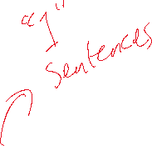
The KEY to good Pol-Soc Writing –
Three Interlocking Layers
Key Thinkers
Key Concepts
Well-Sourced Case Studies
Putting You
In the Debate

Slide 7



So, if this is what we want to encourage our students to do, we should make it part of their initial marking scheme… (it seems to me, anyway)
Theoretical/ Abstract
National/
Global
Personal Insights

Slide 8
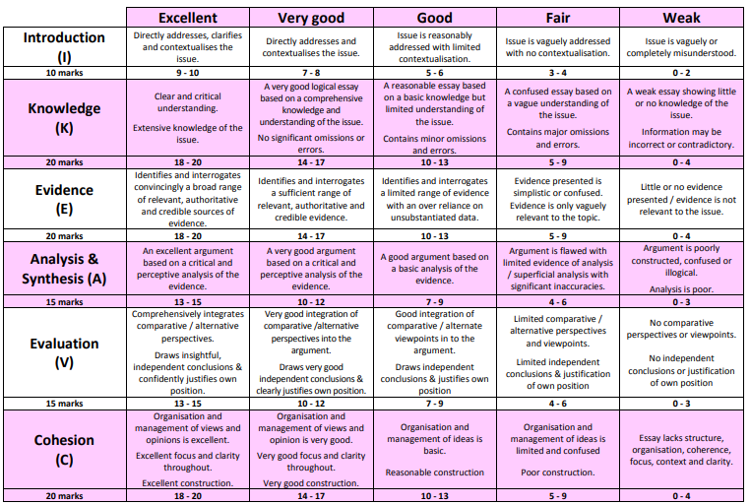
Thinking about the Pol Soc Marking Scheme
- vs PCLM (English) or Paragraph Marking (History)

Slide 9
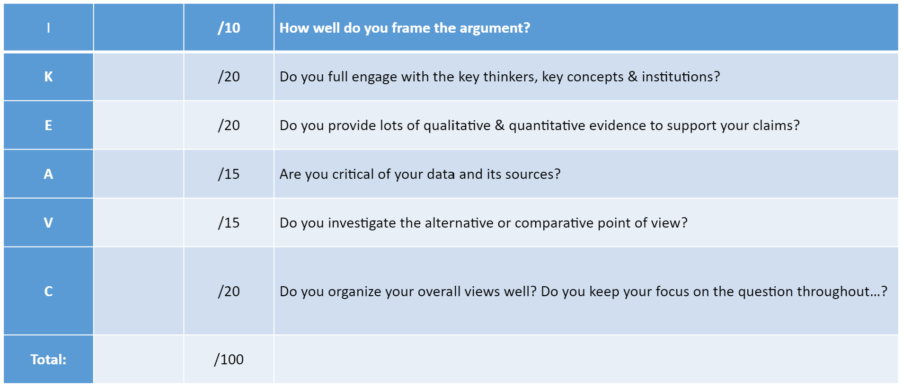
It has been my experience that students don’t really “Get” the complicated marking scheme (at least not in fifth year…)

Slide 10
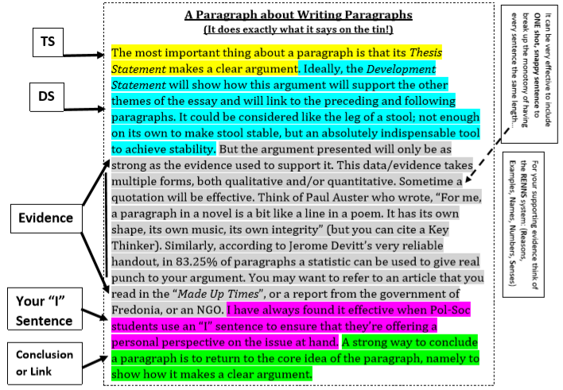
The ‘Building Blocks’ of your Essay – The Paragraph

Slide 11
A Worked example of converting class content into essay content… (Health Inequality)
See separate handout
Yes, I know that this involves A LOT of “hand-holding”. I hate doing that, but I’ve found a significant minority of students have REALLY struggled to this…
I don’t know if that’s a “Covid-19” thing, a “lack of essay at Junior Cycle” thing, or whatever...
I’m just having to rely on a lot more “direct instruction”. But I do also know that this will make it harder for them to link between different strands of the course…
But what I do know is: “If they can’t master an individual strand, they have next to no chance of mastering interweaving strands.”

Slide 12
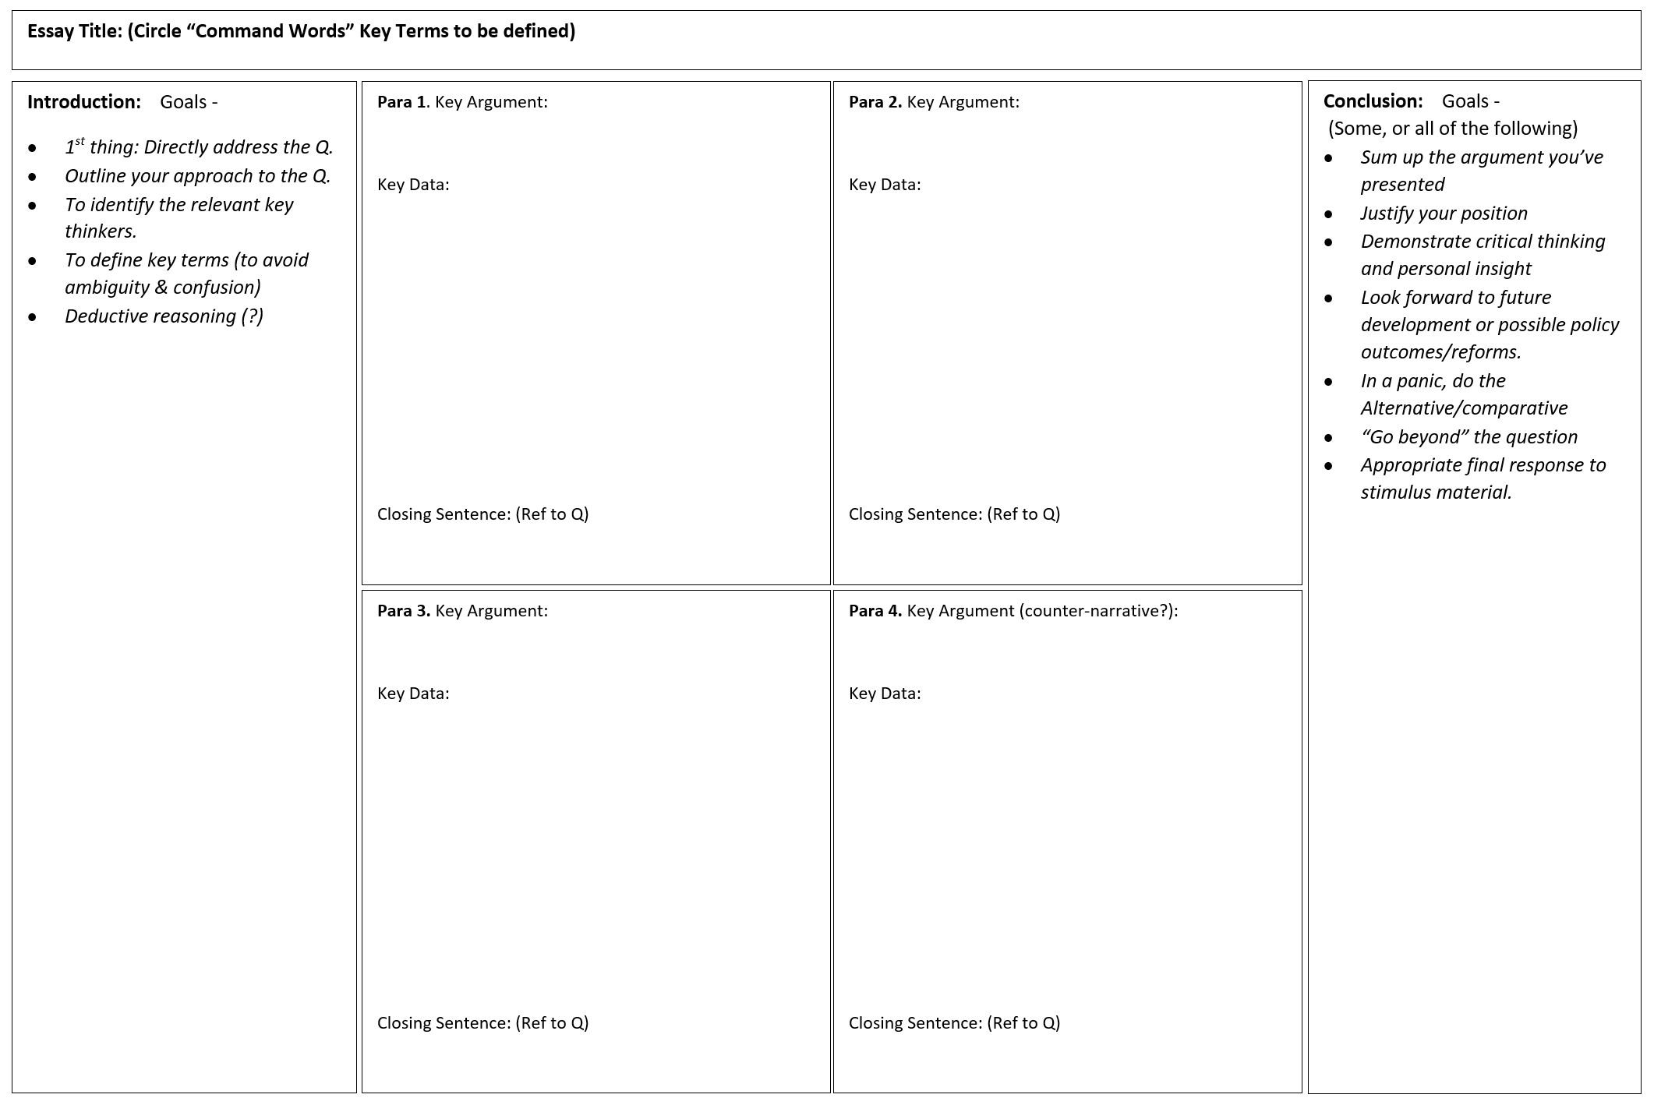
Scaffolding the students writing.
Helping them to think for themselves:

Slide 13
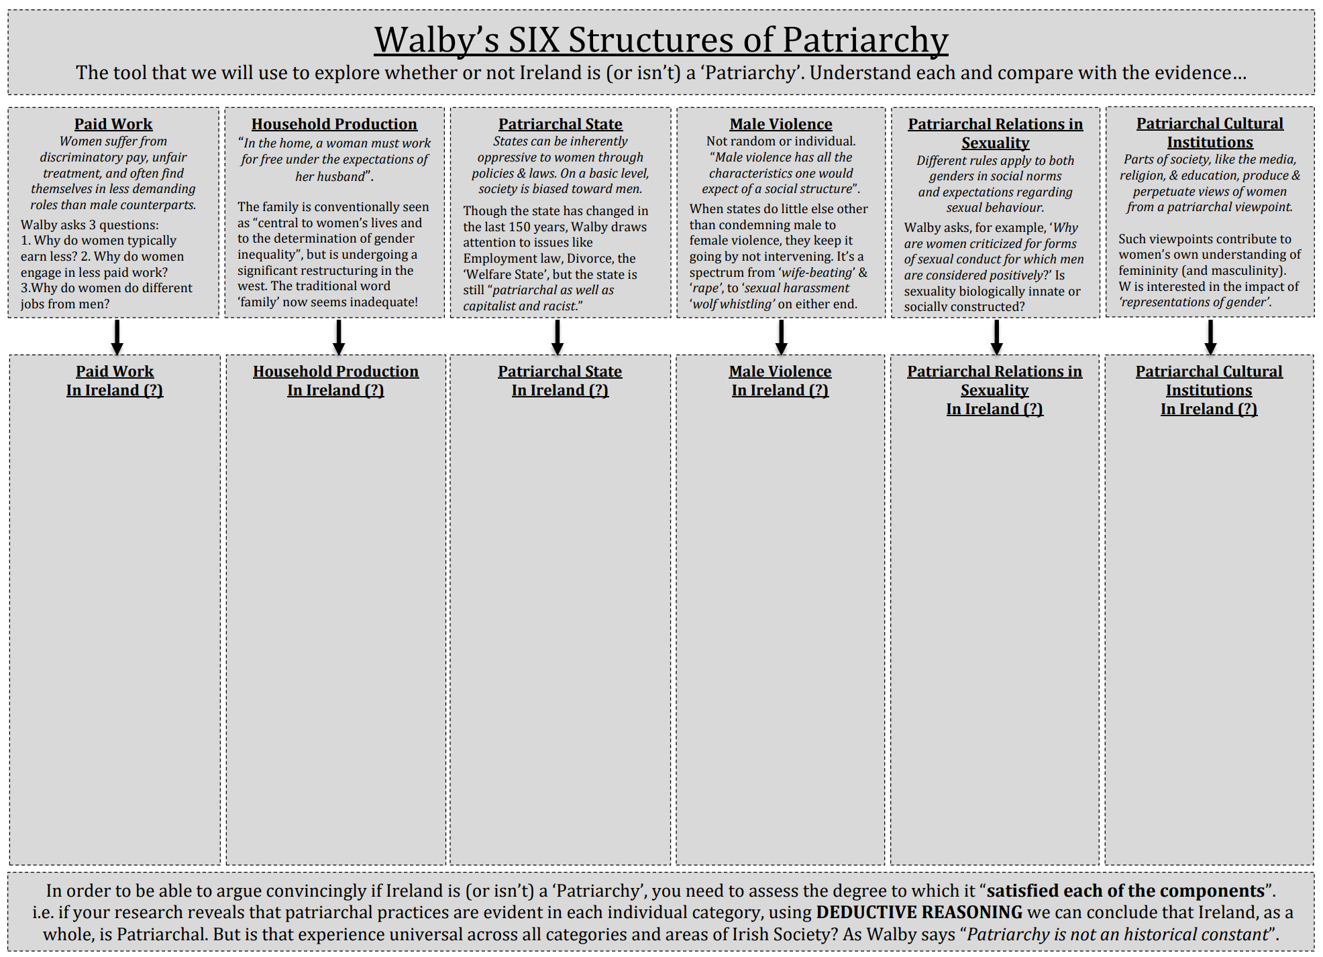
Let them do the work (where at all feasible!) – an A3 Sheet…

Slide 14
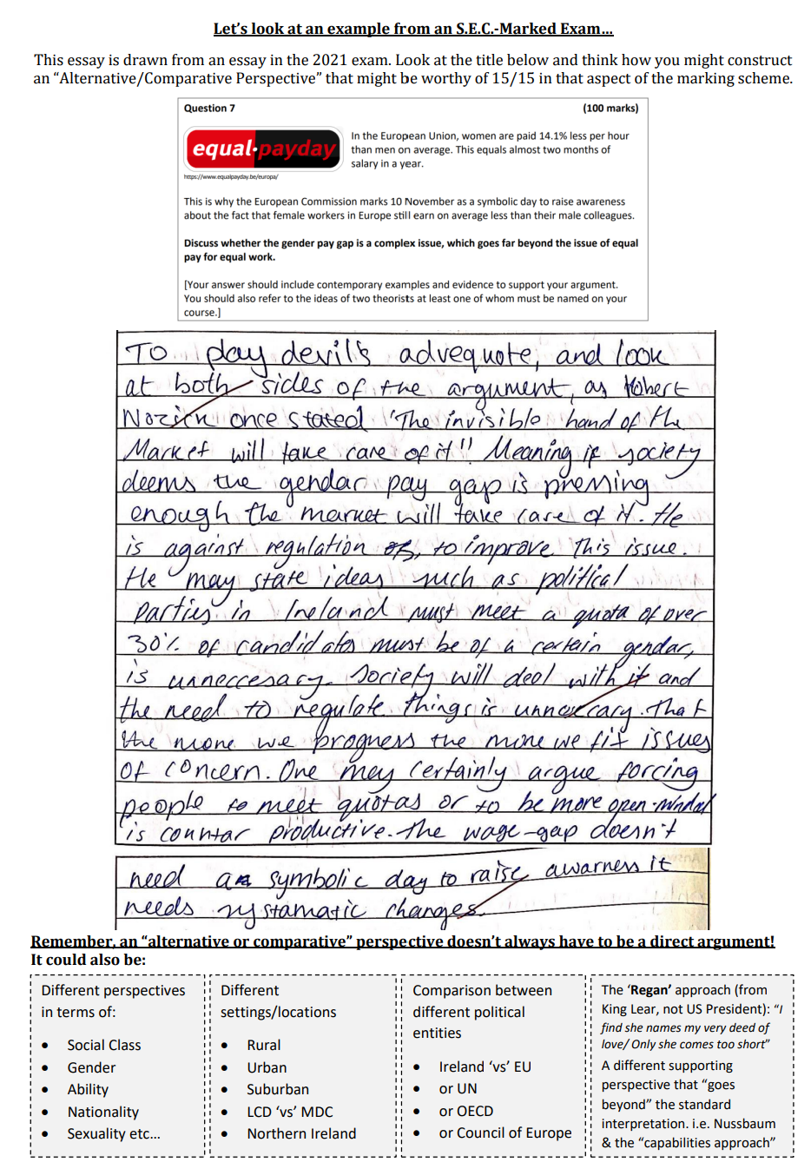
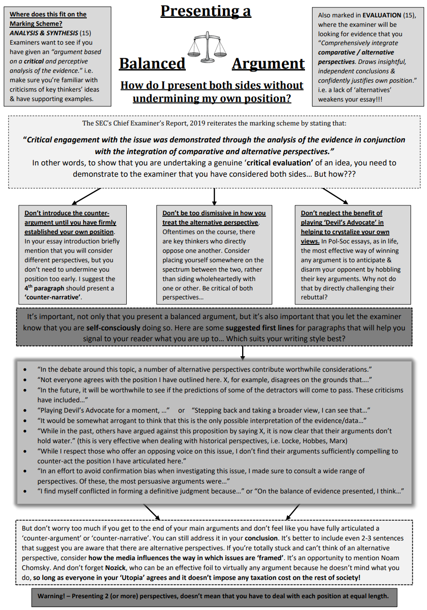
Alternative and Comparative Approaches (15%)

Slide 15
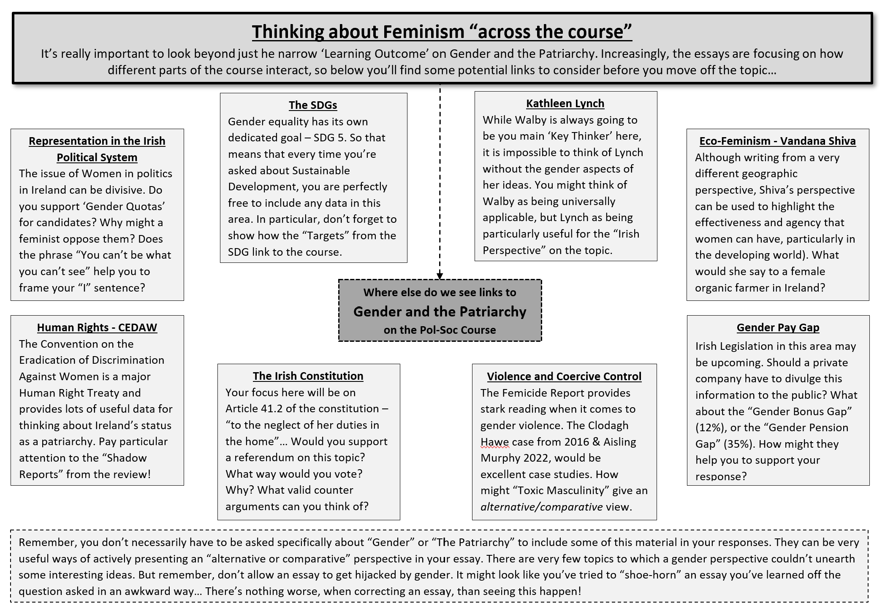

Slide 16
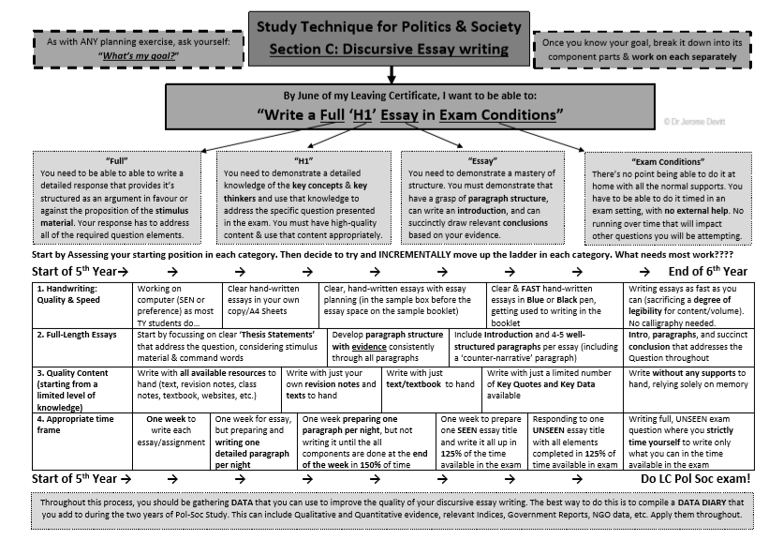

Slide 17
Dealing with the Stimulus Material
There’s no right or wrong way to do this, but here are some possibilities…
It doesn’t have to dominate your answer…
Can you offer a critical evaluation of the origin/source of the material?
Source of the structure of your Introduction and/or Conclusion –
TOP, TAIL, and SPRINKLE
But don’t ignore it either!
This isn’t always possible but can be very impressive (when done well!)
A strong way both to prove your point, and to have a satisfactory RHETORICAL STRUCTURE is to reflect the opening of the essay at the end – i.e. return to your starting point
If you are given a tweet, conclude with your own tweet that responds to the original.
If you’re critically evaluating a picture or cartoon, say how you would change/alter the picture to better reflect the world as you see it.
If you’re given a quote, respond with another quote. Build to a peak…

Slide 18
Questions?.... jeromedevitt@gmail.com j.devitt@thekingshospital.ie

