Slide 1
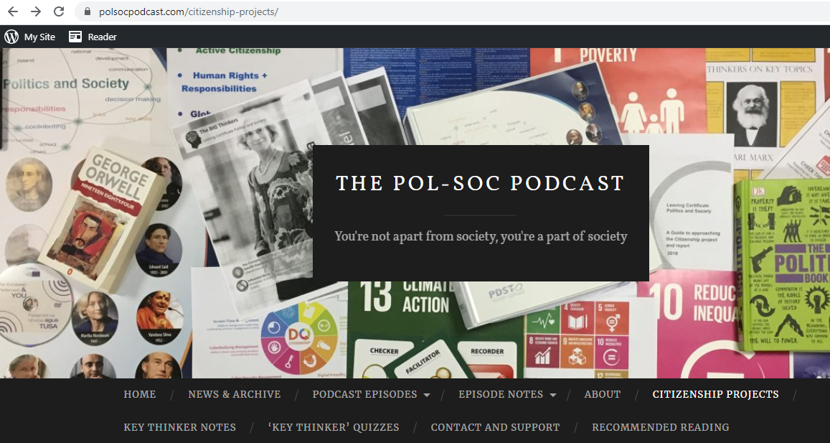

PolSocPodcast.com Screencast #4
Citizenship Project
Section C - Reflection
Squeezing everything you need into the allotted space!

Slide 2
Common Mistakes: - Efficiency Throughout…
Too much rambling “around” the point
Overdoing one section to the detriment of other areas
Not focusing on specific areas from the marking scheme
Reiterating previously made points
Losing focus by not writing under headings
Mentioning skills here that you hadn’t previously illustrated in your Section B
Writing that is too generic – (List + one EXAMPLE)
Too many aspects of the course referenced

Slide 3
One little Caveat….
This is the one area of the Citizenship Project where the marking did change somewhat between the 1st and 2nd year of the subject being examined
In 2018, it was effectively 5 x 4 marks (with each sub-heading being equally weighted
In 2019, more attention was placed on the “Knowledge & Insight” (6) and “Skills” (6), with less attention being placed on the other elements (2 x 4 marks)
What does this mean for 2020 and beyond? Nobody knows!!! But given the small “Sample Size”, my suggestion is just to go with how they did it last year. You don’t have control over any other factors here…

Slide 4
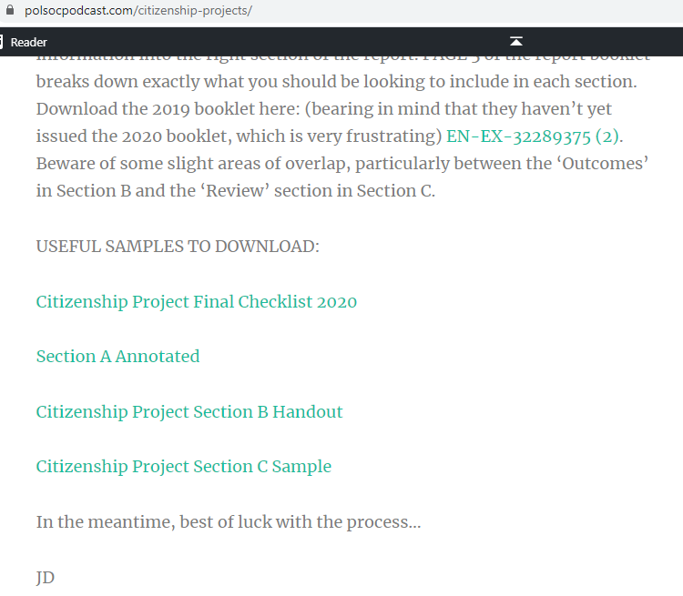

Slide 5
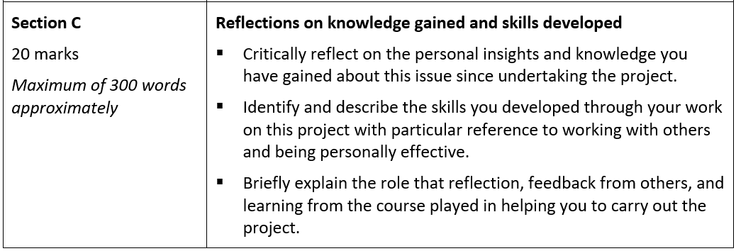
The Bible: Make sure you’re doing what you were actually asked to do…!!!

Slide 6
The Bible: Make sure you’re doing what you were actually asked to do…!!!
???????????????

Slide 7
The Bible: Make sure you’re doing what you were actually asked to do…!!! 4 Headings

Slide 8
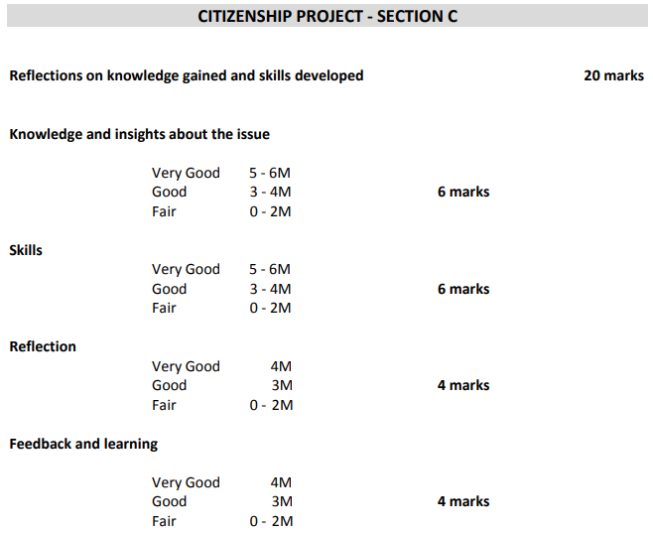
Where should you focus to maximize your marks?

Slide 9
Where should you focus to maximize your marks?
The WORD COUNT PROBLEM:
Knowledge & Insights:
  6 Marks ≈ 90 Words
Skills:
  6 Marks ≈ 90 Words
Reflection:
  4 Marks ≈ 60 Words
Feedback & Learning:
  4 Marks ≈ 60 Words
This is EXTREMELY TIGHT – there’s no wiggle room!

Slide 10
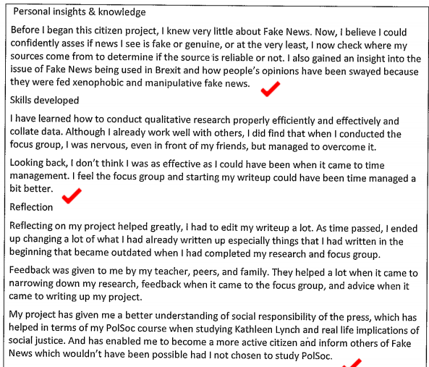
How was this marked?
Based on what you already know about applying the Marking Scheme to the work, how would you mark this under the 4 headings?
Knowledge & Insights: __ /6
Skills: __ /6
Reflection: __ /4
Feedback & Learning: __ /4

Slide 11
How was this marked?
Based on what you already know about applying the Marking Scheme to the work, how would you mark this under the 4 headings?
Knowledge & Insights: 5 /6
Skills: 6 /6
Reflection: 2 /4
Feedback & Learning: 2 /4
Total: 15/20
You might notice that the last 4 lines here are, effectively, just another rehashing of the “Knowledge & Insights” section. The quickest fix would have been to reassign those 4 lines, giving two lines each extra to both “Reflection” and “Feedback”.

Slide 12
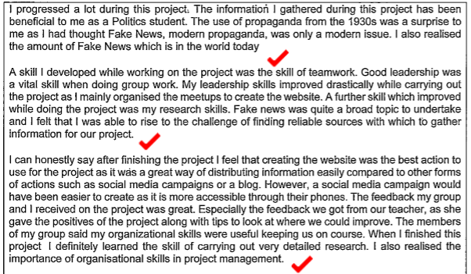
How was this marked?
Based on what you already know about applying the Marking Scheme to the work, how would you mark this under the 4 headings?
Knowledge & Insights: __ /6
Skills: __ /6
Reflection: __ /4
Feedback & Learning: __ /4

Slide 13
How was this marked?
Based on what you already know about applying the Marking Scheme to the work, how would you mark this under the 4 headings?
Knowledge & Insights: 3 /6
Skills: 6 /6
Reflection: 2 /4
Feedback & Learning: 2 /4
Total: 13/20
Oh my gosh, its only 288 words??? What might that extra 12 words have added?
Headings needed!
Personally effective? (pretty much ignored)
Last 3 ½ lines don’t add much in any specific category of the marking scheme

Slide 14
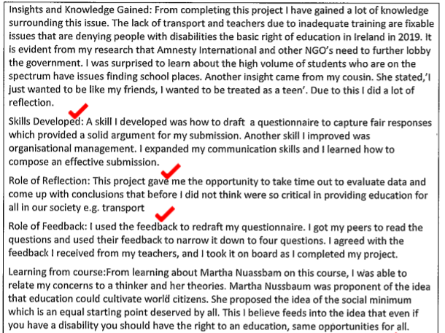
How was this marked?
Based on what you already know about applying the Marking Scheme to the work, how would you mark this under the 4 headings?
Knowledge & Insights: __ /6
Skills: __ /6
Reflection: __ /4
Feedback & Learning: __ /4

Slide 15
How was this marked?
Based on what you already know about applying the Marking Scheme to the work, how would you mark this under the 4 headings?
Knowledge & Insights: 6 /6
Skills: 6 /6
Reflection: 3 /4
Feedback & Learning: 3 /4
Total: 18/20
What’s good?
Clear Headings
Specific elements identified
Short, but efficient ‘Skills’ section
Last line of ‘insights’ should have been in the ‘Reflection’ section
Don’t know how the Feedback & Learning could have been improved????

Slide 16
Best of Luck with this section of the Report!
This section is clearly the most challenging to fit your thoughts into the available space.
You must be disciplined and keep to the suggested word count
The more personal engagement you can demonstrate the better!
List + example
Reflect upon ideas that you have previously undertaken to ensure that there is a consistent thread weaving throughout your project!

Slide 17
Remember to subscribe to the website for future resources!
www.polsocpodcast.com click “Subscribe” on the home page!
@khpolsoc (on twitter)
@PolSocTeachers (on twitter)

