Slide 1
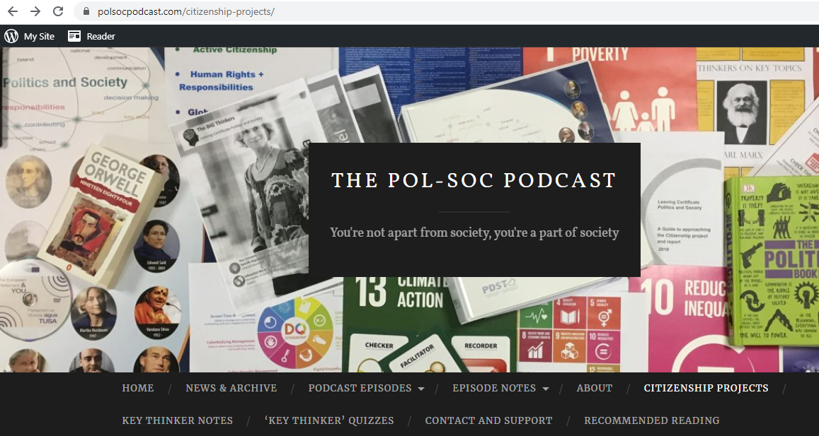

PolSocPodcast.com Screencast #2
Preparing and Structuring your Essay
Learning Outcome 4.1 – Human Rights
Evaluate the statement: “The rights articulated in the UN Convention on the Rights of the Child are enjoyed in Ireland equally by everyone.”

Slide 2
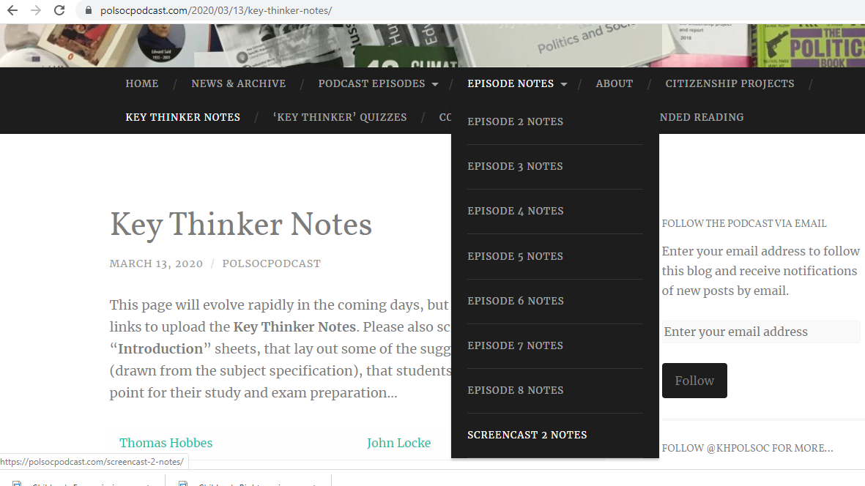
Additional Resources for this Essay:

Slide 3
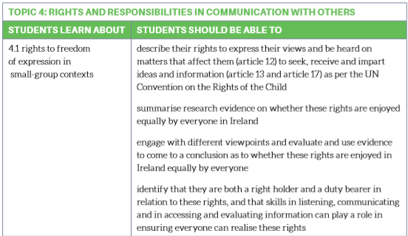
Where did this title come from?

Slide 4
Where did this title come from?

Slide 5
Where did this title come from?

Slide 6
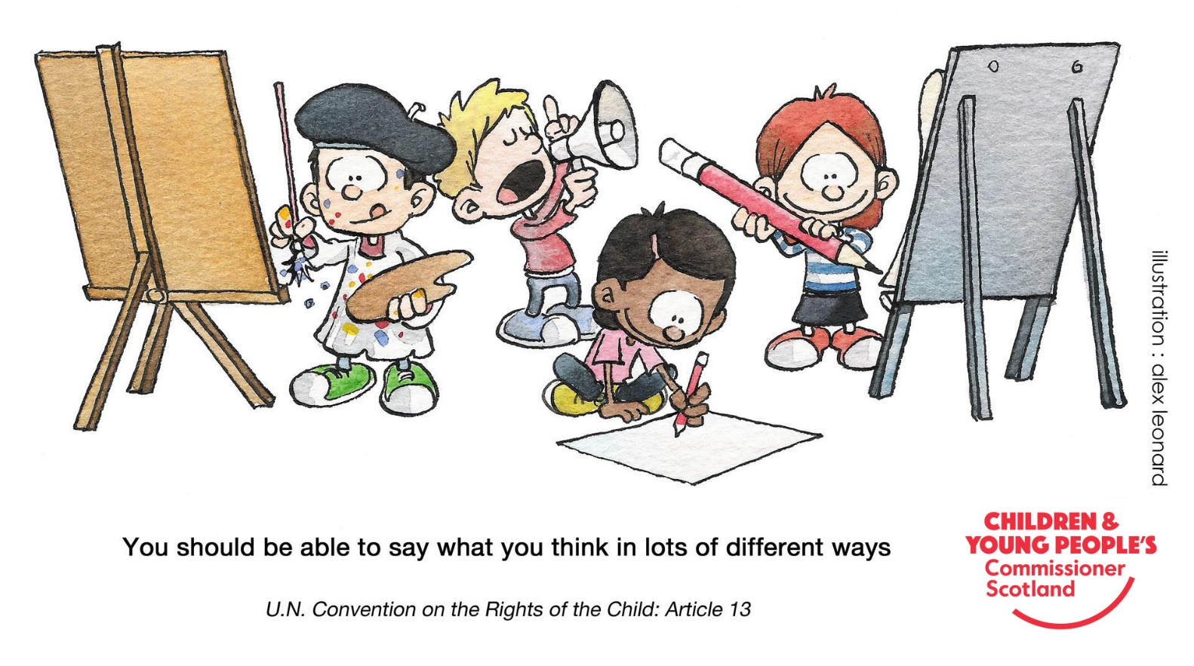
How might this be asked in the exam?
Bearing the ideas expressed in the above cartoon in mind, evaluate the statement: “The rights articulated in the UN Convention on the Rights of the Child are enjoyed in Ireland equally by everyone.”

Slide 7
How might this be asked in the exam?
Stimulus Material
Core Question
Bearing the ideas expressed in the above cartoon in mind, evaluate the statement: “The rights articulated in the UN Convention on the Rights of the Child are enjoyed in Ireland equally by everyone.”

Slide 8
Planning Your Response – What are the options?
ATFQ – “Answer The Flippin’ Question
The Rights in the UNCRC ARE enjoyed Equally Equally Well
Equally Poorly
The Rights in the UNCRC ARE NOT enjoyed Equally
Disproportionately Overwhelmingly Exclusively
by some by some by a certain group(s)

Slide 9
Planning Your Response – What are the options?
ATFQ – “Answer The Flippin’ Question
The Rights in the UNCRC ARE enjoyed Equally Equally Well
Equally Poorly
The Rights in the UNCRC ARE NOT enjoyed Equally
Disproportionately Overwhelmingly Exclusively
by some by some by a certain group(s)

Slide 10
Planning Your Response – What are the options?
ATFQ – “Answer The Flippin’ Question
The Rights in the UNCRC ARE enjoyed Equally Equally Well
Equally Poorly
The Rights in the UNCRC ARE NOT enjoyed Equally
Disproportionately Overwhelmingly Exclusively
by some by some by a certain group(s)
Unequal by CLASS, GENDER, CITIZENSHIP STATUS, SEXUALITY, ETHNICITY

Slide 11
Planning Your Response – What are the options?
ATFQ – “Answer The Flippin’ Question
The Rights in the UNCRC ARE enjoyed Equally Equally Well
Equally Poorly
The Rights in the UNCRC ARE NOT enjoyed Equally
Disproportionately Overwhelmingly Exclusively
by some by some by a certain group(s)
Think about Ireland’s VERY POOR history of Child Protection – Magdalene Laundries, Ferns Report, Irish Child Abuse Commission (2009)

Slide 12
Essay Introduction: How to frame your response
Establish what the Rights in the UNCRC actually are (focusing in on the rights that you will actually be interrogating
  Options specified on the spec include: Article 6 – Survival and Development, Article 13 - Freedom of Expression and availability of information, Article 19 – Protection from Abuse and Neglect, Articles 28 & 29 – Education, Article 31 – Leisure, Recreation, and Cultural Activities
  Of course, you can add in your own choices, but perhaps better to stick to the core!
Identify the Key Thinkers that will help you to think more clearly about this issue
  Kathleen Lynch – Access to Care & Education
  Martha Nussbaum – Capabilities Approach (for your conclusion)
  Marx – Social Class Dimension
  Walby – Gender Dimension

Slide 13
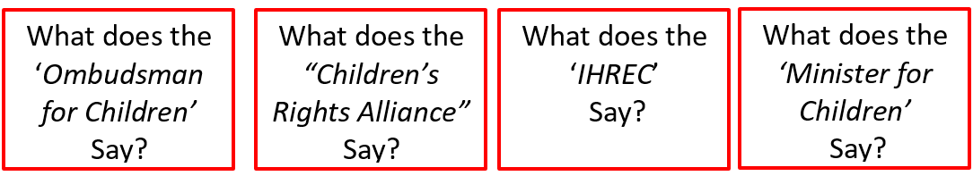
How do you find out the current Irish situation?
www.oco.ie
How are complaints made and resolved?
CRA’s Annual
“Report Card”
Feedback on different categories.
What are the trends over time?
Examine their reports all of which are available to download www.ihrec.ie
How has the state responded to criticism? What public statements has the Minister made about Children’s Rights?

Slide 14
How do you find out the current Irish situation?
Can you think about any other possible source of reliable data? Newspaper articles, documentaries, Government Reports… (You can include what you’ve used in the ‘comments’ below the video?
The links to all of these areas will be included in the ‘Description Box’ and in the Episode Notes…

Slide 15
Kathleen Lynch and Access to Education
“Equality of Condition”
This is an excellent way to present the ideas of a Key Thinker
What specific aspects of inequality in Irish Education does she identify? Which of these link best with your previous arguments?
Balance the ideas of the Key Thinker with your own perspective and experiences in Education in Ireland
How would you frame your “I” sentences to demonstrate to the examiner that you have fully engaged with Lynch’s ideas?
Examine the handout “Kathleen Lynch Notes” at https://polsocpodcast.com/2020/03/13/key-thinker-notes/ particularly the suggestions on Page 3 of the handout

Slide 16

Remember to Include:
“Alternative and Comparative Perspectives”
Our goal here is to be able to put the situation in Ireland into context
What other comparative perspectives could you use? Put suggestions in the comments box below!
Links to all of these areas in the Description box, below…

Slide 17
Thinking about “Case Studies” to support your position
The “Children’s Rights Referendum”
31st Amendment to the Constitution
“Molly – Two years On”
Ombudsman for Children’s Office
How did the referendum come about?
What were the arguments ‘in favour’ and ‘against’ passing the amendment?
What was the result?
Why is the “turnout” important to consider in this context?
A Quantitative Case Study
Follow the case of “Molly” and assess whether you think that the Ombudsman has “Vindicated” her rights?
How might we be critical of this source?
What data can you provide that demonstrates the applicability of this case study?
A Qualitative Case Study

Slide 18
Framing your ‘Conclusion’
All good Pol Soc Essays have a clear conclusion
A useful position to bring in your 2nd Key Thinker – Martha Nussbaum
  What is the point of having all these named rights if a child doesn’t have the ‘Capability’ to access them equally
Move beyond the question: Don’t just stick with identifying the problem.
  What possible solutions can you suggest?
  Does your investigation of ‘comparative’ perspectives offer any models that might be applicable to Ireland?
Briefly return to the question (both ‘stimulus material’ and ‘core question’) and reinforce your answer based on the “Preponderance of Evidence” presented in your essay

Slide 19
Remember, this is only just ONE way to approach this question… There are many, many other ways to do it. You shouldn’t see this as prescriptive, but rather one way to structure your response to this question
You might consider ‘liking’ this video and ‘subscribing’ to the channel to help other students find it more easily
Remember, you can include some of the ideas you used in your essays in the comments section below so that other students can benefit from your work
Thanks to my 10 year old son, Eoin, for his help in making these videos!
(His channel is ‘gamingwithwags’ apparently, I have to ask you to subscribe to it...)

